Slide 1

Using Spotify Insights to Understand Song Popularity
Musab Rahim, Ifa Nira, Kaarjan Thayantham and Rohan Ram

Slide 2
Aim
Our aim is to understand the musical trends which have dictated popularity
We seek to understand the specific characteristics that contribute to a song's popularity.
We are interested in analyzing whether the presence of explicit content in a song increases its likelihood of gaining popularity
Our objective is also to identify the most popular artists, as partnering a song with a well-received artist could significantly enhance its chances of success.
We hope this will inform decision making over future music production

Slide 3
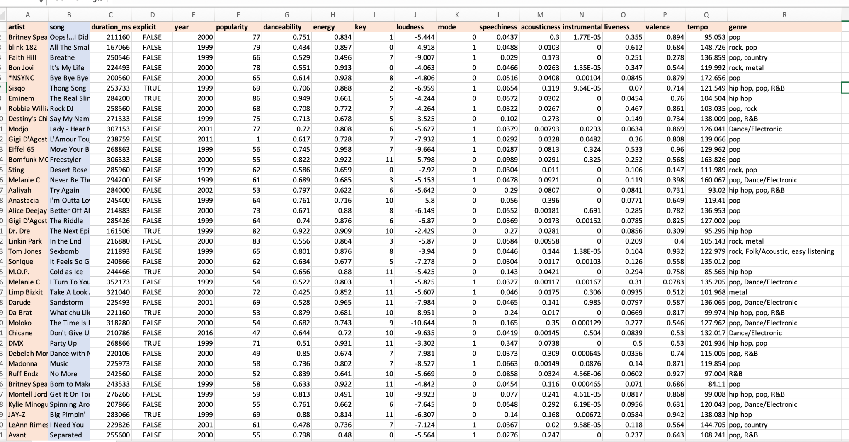
Dataset
We decided to use the data from Spotify which was available as a dataset on Kaggle as “Top Hits Spotify from 2000-2019 by Mark Koverha. https://www.kaggle.com/datasets/paradisejoy/top-hits-spotify-from-20002019

Slide 4
Song Attributes
Energy - A perceptual measure of intensity and activity. Measured from 0.0-1.0
Loudness - The overall loudness of a track in decibels (dB). Values typically range between -60 and 0 db.
Valence - : The musical positiveness conveyed by a track. Ranging from 0.0-1.0
Acousticness - : A confidence measure from 0.0 to 1.0 of whether the track is acoustic
Danceability - How suitable a track is for dancing based on a combination of musical elements. Measured from 0.0-1.0
Tempo - The overall estimated tempo of a track in beats per minute (BPM)
Liveness - Detects the presence of an audience in the recording. Measured from 0.0-1.0
Speechiness - Detects the presence of spoken words in a track. Low values are more instrumental, higher ones are more spoken word. Measured from 0.0-1.0
Duration_ms - Duration of the track in milliseconds
Instrumentalness - Predicts whether a track contains no vocals. Measured from 0.0-1.0
Notes:
We will investigate the correlation between musical traits (such as danceability, speechiness, energy, valence, and tempo) and the popularity of songs in the dataset. I want to know whether having a higher or lower duration_ms, danceability, energy, loudness, speechiness, acousticness, instrumentalness, liveness, valence and tempo contributes to having a song popular ober the years, Additionally, we will identify which specific attributes exhibit the strongest correlation with songs that are the most popular.

Slide 5
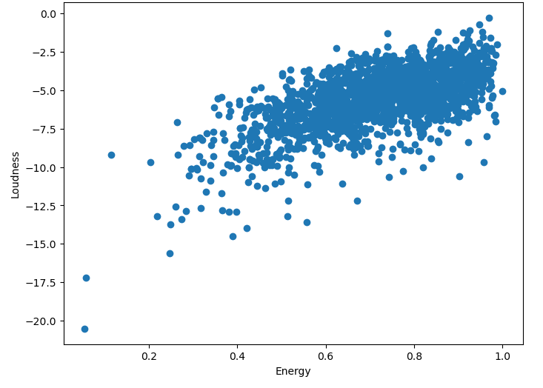
Energy vs Loudness
You would expect a louder song to be more energetic
This is represented on this graph by the data points being clustered in the top right area, showing a strong positive correlation
Notes:
if the data points are closely clustered around a specific region, it suggests a strong relationship or correlation between energy and loudness. On the other hand, if the points are scattered across the graph without a clear pattern, it indicates a weaker or no discernible relationship between the two attributes.
Moreover, if the points exhibit an upward trend, it implies a
positive relationship between energy and loudness. This means that as energy
increases, loudness tends to increase as well. Conversely, a downward trend
would indicate a negative relationship, implying that as energy increases,
loudness tends to decrease.
By observing the scatter graph and considering these
characteristics, you can gain insights into how energy and loudness are related
in your dataset and identify any trends or patterns that exist.

Slide 6
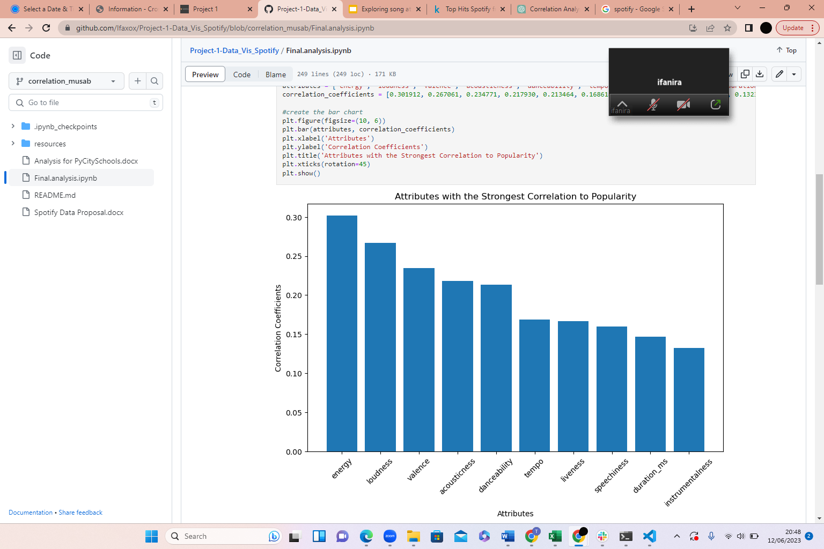
Attributes with the Strongest Correlation to Popularity
Calculated a correlation matrix
Energy and loudness had the strongest correlation to popularity
Duration and instrumentalness had the weakest
Notes:
After conducting a correlation analysis, it was found that energy and loudness exhibited the strongest correlation with popularity. This suggests that there is a significant relationship between the energy level and loudness of a song and its overall popularity.
On the other hand, the attributes of duration and instrumentalness showed the weakest correlation with popularity. This implies that the duration of a song and the presence of instrumental elements have a minimal impact on its overall popularity.
In summary, the correlation matrix revealed that energy and loudness are highly influential factors in determining the popularity of a song, while duration and instrumentalness have relatively less impact in this regard.

Slide 7
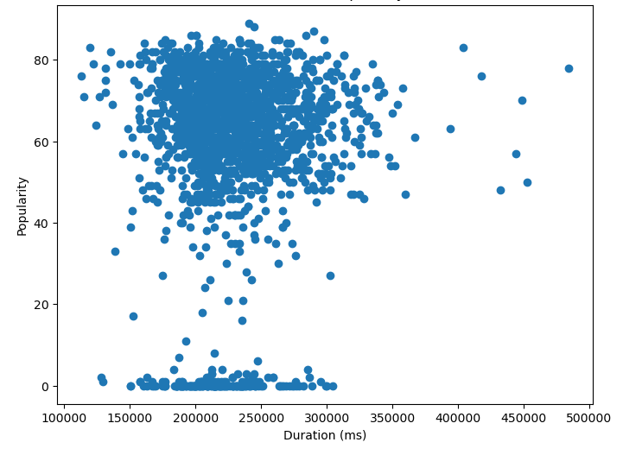
Duration vs Popularity
Correlation coefficient of 0.138354
Cluster of data points towards the top left area - indicating a preference for slightly shorter songs.
Notes:
The correlation coefficient between the attributes is calculated to be 0.138354. This value suggests a relatively weak correlation between the variables under consideration.
By examining the scatter plot, it can be observed that the cluster of data points tends towards the top-left area. This pattern indicates a preference for slightly shorter songs. In other words, there is a tendency for songs with shorter durations to be favored more by the audience.
In summary, while the correlation coefficient indicates a weak relationship between the variables, the distribution of data points in the scatter plot provides valuable insights, showing a preference for shorter songs among the listeners.

Slide 8

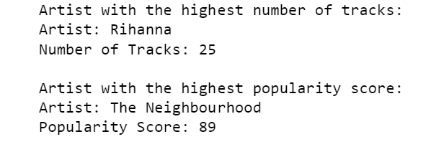

Which artists have the highest number of tracks and the highest popularity scores in the dataset?
Notes:
We then investigated Which artists have the highest number of tracks and the highest popularity scores in the dataset
Among the artists in the dataset, Rihanna stands out with the highest number of tracks.
The analysis of the data revealed that that Rihanna has the most extensive collection of tracks among all the artists in the dataset. With 25 tracks, Rihanna has contributed significantly to the music library.
The Neighbourhood has achieved the highest popularity score among all the artists. With a Popularity Score: 89. This suggests that their songs have resonated well with the audience and have gained a significant level of recognition and acceptance within this data set.
These findings highlight the success and impact of both Rihanna and The Neighbourhood in the music industry. Rihanna's extensive collection of tracks showcases her prolific output, while The Neighbourhood's high popularity score signifies their strong appeal to listeners. These insights can provide valuable information for music industry professionals, researchers, and enthusiasts interested in understanding the achievements and impact of different artists in the dataset.
Next you can see a chart here displaying rihanna's tracks over the years observed. We can see that through years 2008 and 2012 she contributed the most to the data set suggesting that her songs have resonated with the listeners and we suspect the tracks have certain characteristics that correlate with popularity of the track. Such as genre and explicitness for example . That leads us to the next part of our investigation.
The analysis of the data reveals the following:
Artist with the highest number of tracks:
Artist: Rihanna
Number of Tracks: 25
This indicates that Rihanna has the most extensive collection of tracks among all the artists in the dataset. With 25 tracks, Rihanna has contributed significantly to the music library.
Artist with the highest popularity score:
Artist: The Neighbourhood
Popularity Score: 89
The Neighbourhood has achieved the highest popularity score among all the artists. This suggests that their songs have resonated well with the audience and have gained a significant level of recognition and acceptance.
These findings highlight the success and impact of both Rihanna and The Neighbourhood in the music industry. Rihanna's extensive collection of tracks showcases her prolific output, while The Neighbourhood's high popularity score signifies their strong appeal to listeners. These insights can provide valuable information for music industry professionals, researchers, and enthusiasts interested in understanding the achievements and impact of different artists in the dataset.
Can we identify any correlations between artist characteristics (Genre, duration,Track Count) and the popularity of their songs?

Slide 9
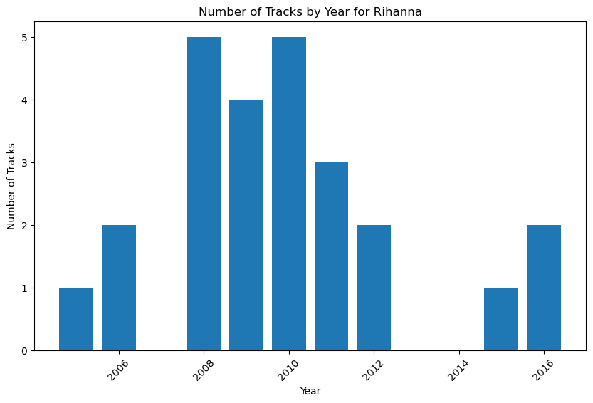
Which artists have the highest number of tracks and the highest popularity scores in the dataset?
Filtered the data for the artist with the highest number of tracks (Rihanna)
Can we identify any correlations between artist characteristics (Genre, duration,Track Count, explicitness) and the popularity of their songs?
Notes:
We then investigated Which artists have the highest number of tracks and the highest popularity scores in the dataset
Among the artists in the dataset, Rihanna stands out with the highest number of tracks.
The analysis of the data revealed that that Rihanna has the most extensive collection of tracks among all the artists in the dataset. With 25 tracks, Rihanna has contributed significantly to the music library.
The Neighbourhood has achieved the highest popularity score among all the artists. With a Popularity Score: 89. This suggests that their songs have resonated well with the audience and have gained a significant level of recognition and acceptance within this data set.
These findings highlight the success and impact of both Rihanna and The Neighbourhood in the music industry. Rihanna's extensive collection of tracks showcases her prolific output, while The Neighbourhood's high popularity score signifies their strong appeal to listeners. These insights can provide valuable information for music industry professionals, researchers, and enthusiasts interested in understanding the achievements and impact of different artists in the dataset.
Next you can see a chart here displaying rihanna's tracks over the years observed. We can see that through years 2008 and 2012 she contributed the most to the data set suggesting that her songs have resonated with the listeners and we suspect the tracks have certain characteristics that correlate with popularity of the track. Such as genre and explicitness for example . That leads us to the next part of our investigation.
Can we identify any correlations between artist characteristics (Genre, duration,Track Count) and the popularity of their songs?

Slide 10
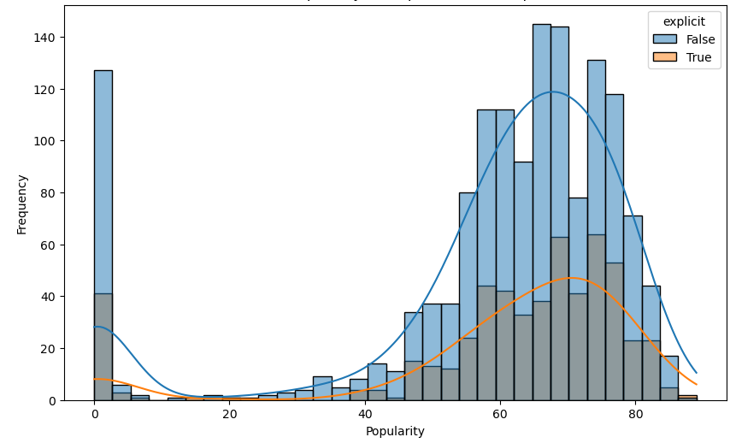
Distribution of Popularity for Explicit vs Non- Explicit Tracks
T-Statistic: 2.085453709873755
P-Value: 0.037154760979321196

Slide 11
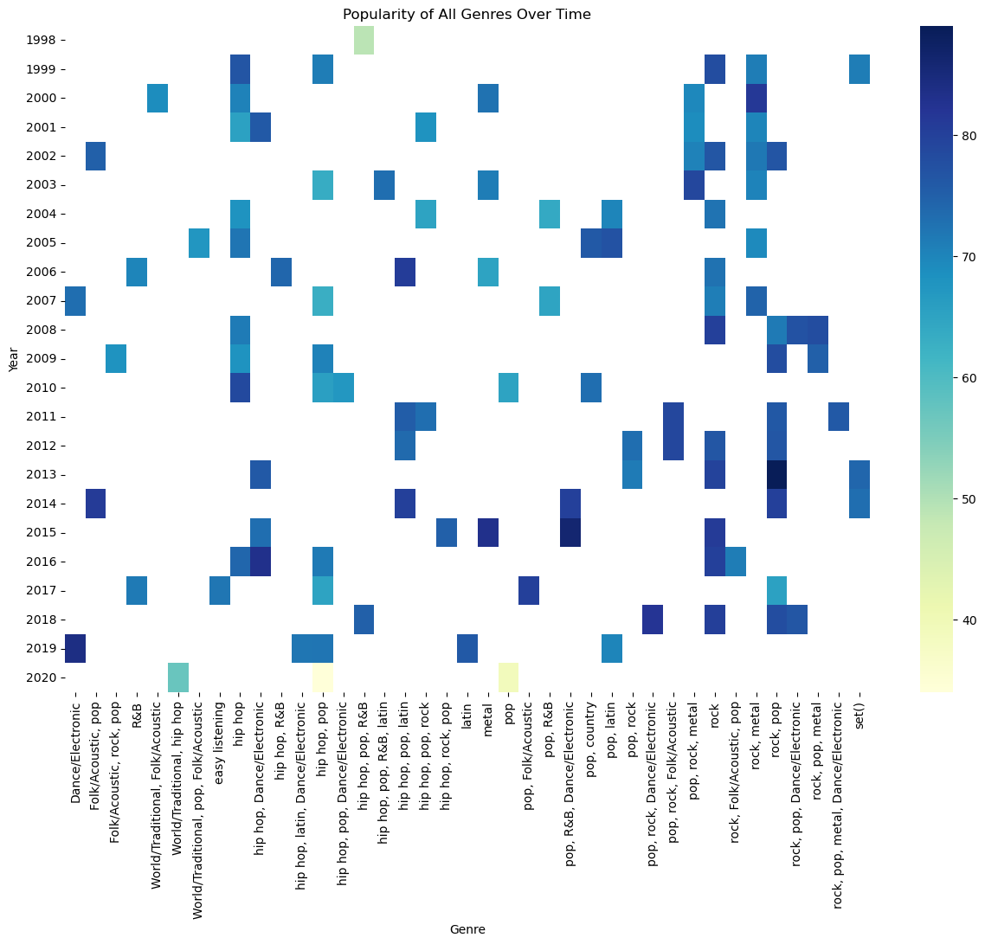
Popularity of All Genres Over Time

Slide 12
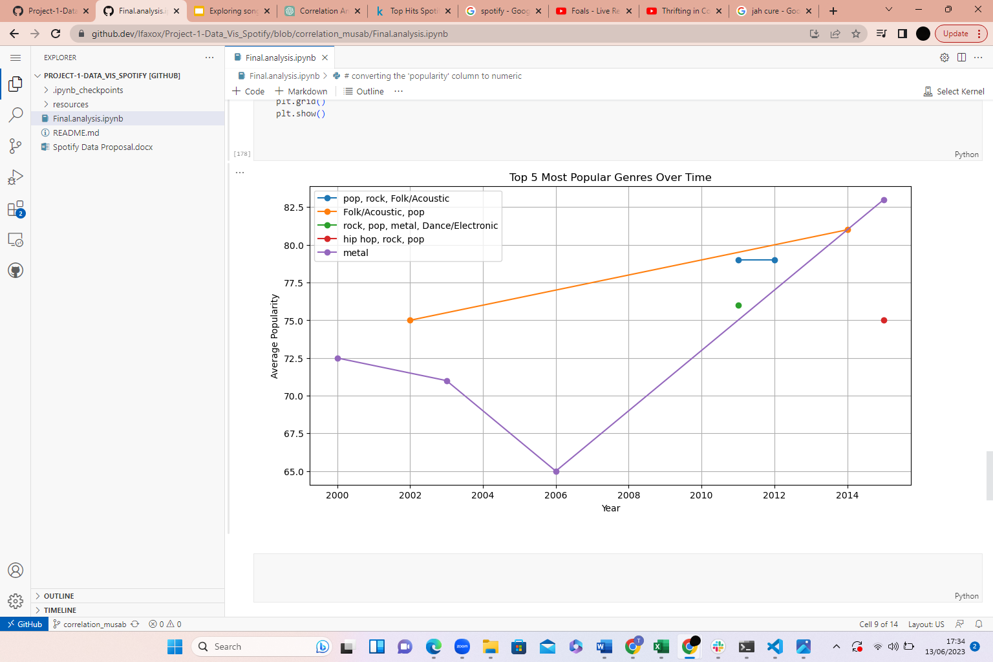
Top 5 Most Popular Genres Over Time

Slide 13
Conclusions
Songs between 3 and 3 and a half minutes tend to be more popular
More explicit songs tend to be more popular
Attributes such as energy and loudness have a higher chance of your song being popular
Collaborations with Rihanna gives your song a higher chance of it being popular
It's important to note that correlation does not imply causation. While you can identify relationships between variables, determining the exact cause-and-effect relationship would require further investigation and possibly experimental studies.

